Slide 1
Transport priorities
December 2025

Slide 2
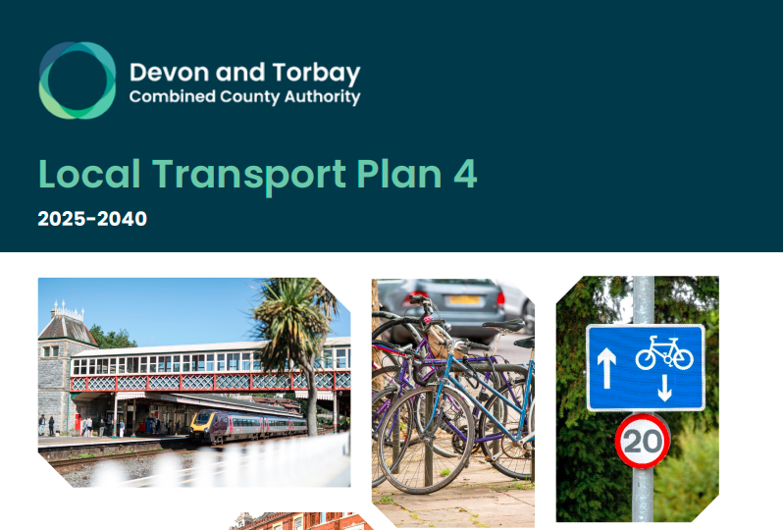
Local Transport Plan
2025-2040 strategy
Now lead and delivered by the new D&T CCA

Slide 3
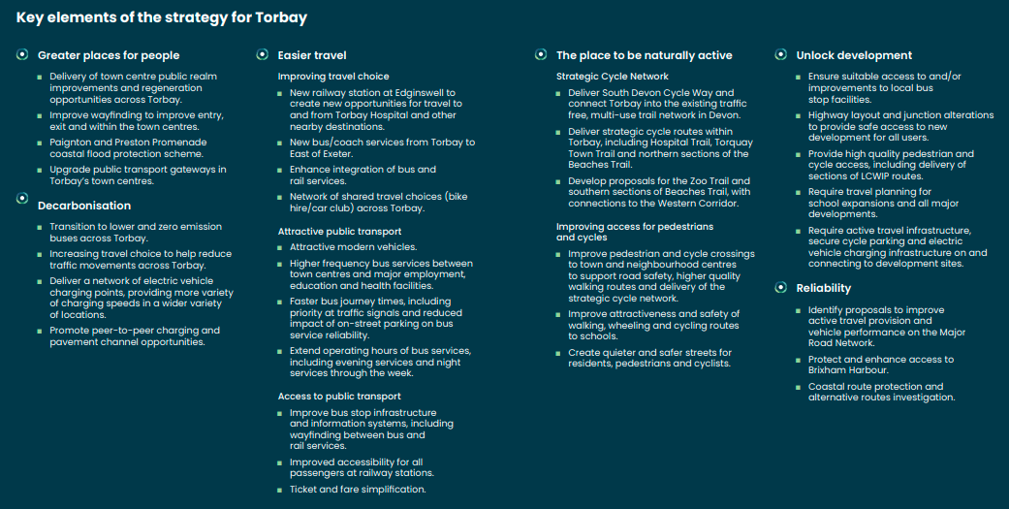
Key strategic priorities

Slide 4
Greater places for people
Delivery of town centre public realm improvements and regeneration opportunities across Torbay.
Improve wayfinding to improve entry, exit and within the town centres.
Paignton and Preston Promenade coastal flood protection scheme.
Upgrade public transport gateways in Torbay’s town centres

Slide 5
Greater places for people
Abbey Gates enhancements in Torquay, redevelopment around the bus and rail station and surrounding brownfield sites in Paignton
Enhancements to Brixham Bank Lane and Paignton bus station, scheduled for 2026
Work with the rail industry to enhance the Paignton station concourse and station facilities.
Work with rail and bus operators to improve the connectivity and ticketing opportunities (Frequency improvements on major bus lines in 2025, multi-operator ticket trial in 2026)
Make it easier for people to access longer distance travel networks from Brixham (Rail ticket to Brixham connecting with Stagecoach services)

Slide 6
Decarbonisation
Transition to lower and zero emission buses across Torbay.
Increasing travel choice to help reduce traffic movements across Torbay.
Deliver a network of electric vehicle charging points, providing more variety of charging speeds in a wider variety of locations.
Promote peer-to-peer charging and pavement channel opportunities.
Notes:
54 new double decker and electric buses buses

Slide 7
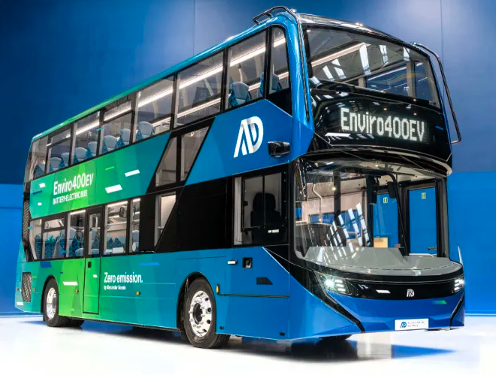
Decarbonisation
Torbay Council’s EV Strategy to deliver a comprehensive charging network for Torbay, on-street, car park and rapid charge points
£25 million (£7 million DfT funding) ZEBRA electric bus project to replace 80% of Torbay buses in the new year (2026)
Delivery of Bay trails active travel infrastructure improvements
Notes:
54 new double decker and electric buses buses. £7.1m funding to deliver zero-emission bus fleet for Torbay - Torbay Council

Slide 8
Easier travel
Improving travel choice
New railway station at Edginswell to create new opportunities for travel to and from Torbay Hospital and other nearby destinations.
New bus/coach services from Torbay to East of Exeter.
Enhance integration of bus and rail services.
Network of shared travel choices (bike hire/car club) across Torbay. Attractive public transport
Attractive modern vehicles
Higher frequency bus services between town centres and major employment, education and health facilities.
Faster bus journey times, including priority at traffic signals and reduced impact of on-street parking on bus service reliability.
Extend operating hours of bus services, including evening services and night services through the week. Access to public transport
Improve bus stop infrastructure and information systems, including wayfinding between bus and rail services.
Improved accessibility for all passengers at railway stations.
Ticket and fare simplification

Slide 9
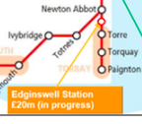
Easier travel
Improved bus provision to Torquay gateway, Newton Abbot, Heathfield and Totnes
New railway station at Edginswell
Redesign bus interchanges at Paignton station and Brixham (2026)
Shared cross-operator bus ticket and new rail ticket to Brixham
Connecting Goodrington to the rail network
Developing a network of at least 15-minute bus service frequencies along key corridors, including services 13 (Brixham - Torbay Hospital) and 22 (South Devon College – St Marychurch).
Improved technology at signalised junctions to give buses priority on key corridors.
Increasing frequency and accessibility of services across the community
Bus stop improvements:
15 new shelters, new maps and timetables
New, clearer and more attractive branding
Better access by foot and cycle
Better waiting facilities, including shelters and build outs
New real time information for passengers at the busiest stops and rail stations
Notes:
£1.1M spent on frequency and service improvements in 2025-26 to develop the bus network. 2025-26-bsip-delivery-plan-torbay-for-publication.pdf

Slide 10
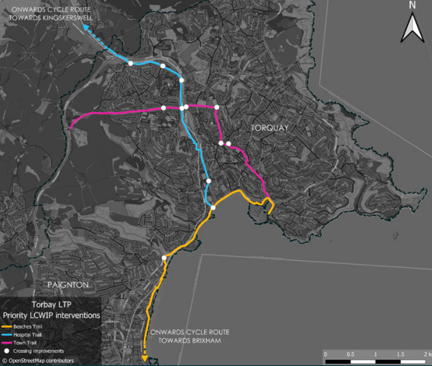
The place to be naturally active
Strategic Cycle Network
Deliver South Devon Cycle Way and connect Torbay into the existing traffic free, multi-use trail network in Devon.
Deliver strategic cycle routes within Torbay, including Hospital Trail, Torquay Town Trail and northern sections of the Beaches Trail.
Develop proposals for the Zoo Trail and southern sections of Beaches Trail, with connections to the Western Corridor. Improving access for pedestrians and cycles
Improving access for pedestrians and cycles
Improve pedestrian and cycle crossings to town and neighbourhood centres to support road safety, higher quality walking routes and delivery of the strategic cycle network.
Improve attractiveness and safety of walking, wheeling and cycling routes to schools.
Create quieter and safer streets for residents, pedestrians and cyclists.

Slide 11
The place to be naturally active
Currently developing 27Km of
Bay Trails:
Hospital Trail
Torquay Town Trail
Beaches Trail (north)
Beaches Trail (south)
Zoo Trail

Slide 12
Unlocking development
Ensure suitable access to and/or improvements to local bus stop facilities.
Highway layout and junction alterations to provide safe access to new development for all users.
Provide high quality pedestrian and cycle access, including delivery of sections of LCWIP routes.
Require travel planning for school expansions and all major developments.
Require active travel infrastructure, secure cycle parking and electric vehicle charging infrastructure on and connecting to development sites.

Slide 13
Unlocking development
Secure improvements to existing sustainable transport facilities as part of the planning process
Supporting regeneration opportunities in the town centres of Paignton and Torquay.
Require electric charging and cycle parking facilities provided as part of new development.
Support the sustainable redevelopment of Torbay Hospital and new employment and residential developments in the Torquay Gateway through major sustainable transport schemes (Edginswell rail station and improvements to bus network)
Enhancing the active travel infrastructure along the ring road and to consider support for further development of the bus network.

Slide 14
Reliability and resilience
Identify proposals to improve active travel provision and vehicle performance on the Major Road Network.
Protect and enhance access to Brixham Harbour.
Coastal route protection and alternative routes investigation.

Slide 15
Reliability and resilience
Targeted changes at locations where they are most needed, such as those with a history of serious or fatal collisions.
Physical infrastructure changes at locations where improvements also benefit public transport, walking, wheeling, and cycling facilities, and/or respond to community concerns.
Trialling layout and access changes in locations where they could improve safety

Slide 16
Questions
Which accessibility improvements would you like in 2026 (e.g. tactile pavement at bus stops)?
Would a shared ticket between operator make a positive difference to your day-to-day commute?
Are there specific services you would like to improve? How and why?
Any safety concerns? When and where?

Slide 17
Torbay Bus Forum
29th January 2026 – 6pm
Paignton (Venue to be confirmed)

